Slide 1
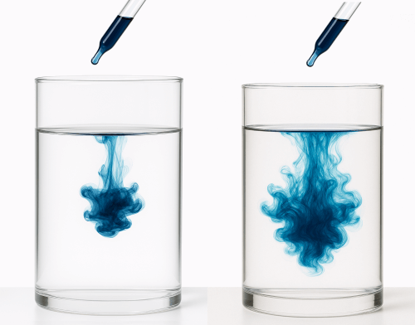
Diffusion Models
A drop of ink is initially concentrated and slowly disperses in the liquid, becoming more and more chaotic.
The randomness that emerges with every passing tick is the result of the ink molecules colliding with water molecules. This is Brownian motion.
Deep Unsupervised Learning using Nonequilibrium Thermodynamics (Jascha Sohl-Dickstein, Eric A. Weiss, Niru Maheswaranathan, Surya Ganguli)
Given the two images, could you approximate where the initial ink drop might have been?

Slide 2
Learning to generate images by learning to generate dice rolls.
Diffusion models aim to generate new images by learning the probability distribution of all images p*(x).
Of course, we cannot map the exact distribution for every possible high-dimensional image (e.g. 1000x1000), so we approximate it as p(x) using training data.
Before diving into image generation, let's explore a closely related problem.

Slide 3
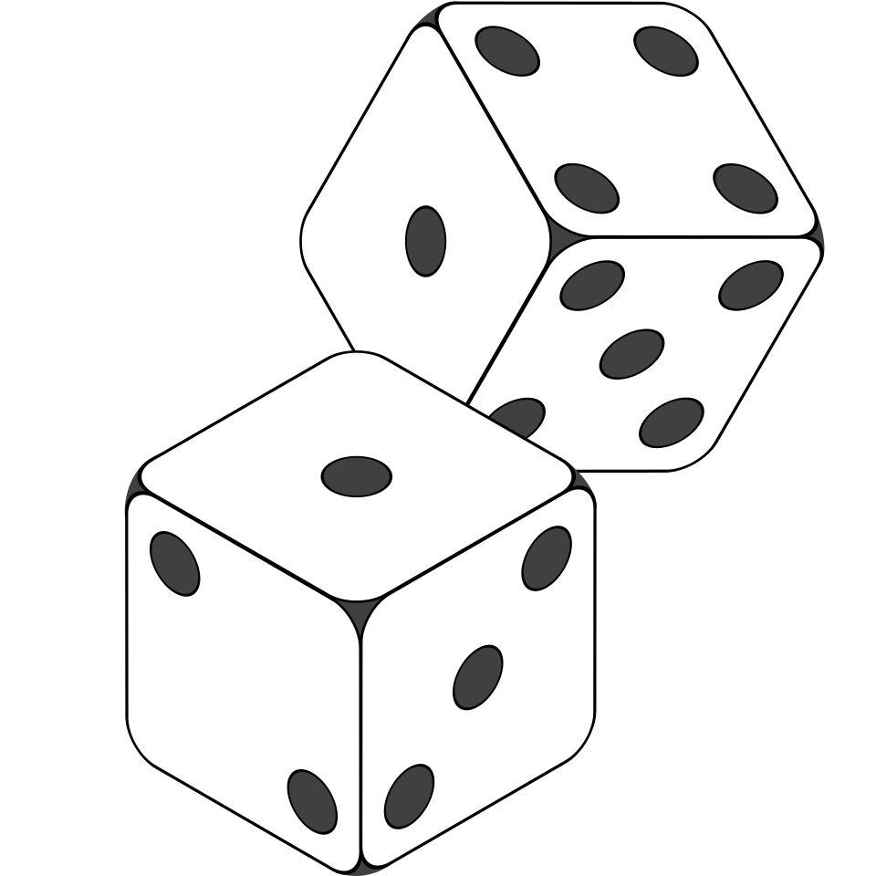
Dice Rolls
How would you write a program that can generate dice roll samples for a fair dice?
We know P(0) = P(1) = P(2) = P(3) = P(4) = P(5) = P(6) = ⅙.
But knowing these probabilities only tells us the behavior of a very large sample size.
It doesn’t directly help us generate individual samples.

Slide 4
Monte Carlo Sampling
If we were trying to generate a new colored image of size 1000 x 1000, can we simply initialize each pixel’s value [0,255] across each color channel randomly and hope for a good image?
If we attempted this, we would almost always get an image with signal-to-noise ratio of almost 0.
Does this work for dice rolls? Yes, because we can bound values within [1,6] and every value is a valid output of a die roll.

Slide 5
Sampling from Uniform Distribution
You might use libraries like numpy.random.uniform to generate uniform samples within range [0,1] and discretize the continuous output into 6 equal-sized buckets.
Now suppose you don’t have access to any of these built-in capabilities but you have access to numpy.random.normal.

Slide 6
Langevin Sampling
There exists an algorithm that lets us generate samples from any probability distribution (approximately) as long as we can:
Generate samples from the Gaussian distribution (some black box algorithm)
Have access to a function F that takes as input a location in the target sample space and returns the direction that most quickly increases the probability that a sample comes from the target distribution.

Slide 7
Gradient Function and Gaussian Noise
F(x) is a gradient function and helps us move from low probability regions to higher probability regions.
Langevin sampling exploits knowledge of the gradients of the PDF. We don’t know the actual PDF.
It guesses an initial value and then iteratively adjusts it using F so that it appears to have been generated from the target distribution.
Random Gaussian noise is added to F(x) to aid in exploration.
If we don’t add the noise, we will simply move towards a high probability region and get stuck at a single peak in the probability landscape.
Think about how this resembles SGD.

Slide 8
Langevin Sampling - the algorithm
Algorithm: Langevin sampling (generates one sample)
x₀ ~ Ɲ(0,1)
for t ← 0 to 1000
z_{t} ~ Ɲ(0,1)
x_{t+1} = x_{t} + (𝜖/2) F(x_{t}) + sqrt(𝜖)z_{t}

Slide 9
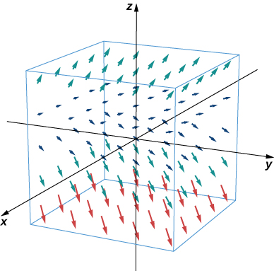

Diffusion models learn F(x)
F is the gradient of the log probability density.
This is a vector field.
We will come back to this but for now, we draw a parallel with Langevin Sampling.

Slide 10
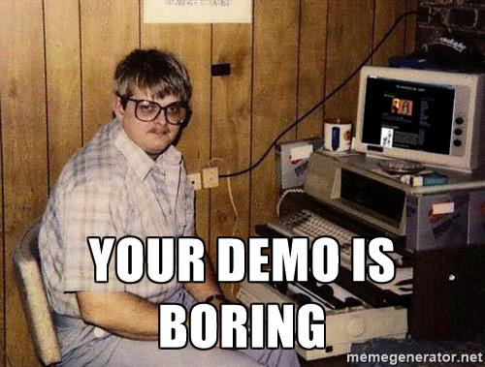
A Quick Visual Demo: diffusion_intuition.ipynb - Colab

Slide 11

Forward Diffusion Process (addn notes)
Markov process with Gaussian transitions: We take each input image and bring it from a high probability regions to low probability regions iteratively.
Remember that each image in our training data is a real image but if we were to draw pixels randomly, our image would look nothing like a real image.
At each step, we produce an image with lower and lower signal-to-noise ratio.
What is the mean and covariance of the normal distribution when Ꞵ_{t} = 0? when Ꞵ_{t} = 1?
Variance schedule
There is a closed-form equation that allows us to sample directly from any x_{t-1} to x_{t}
  All substeps are used in training but direct sampling means lower memory and computational requirements.

Slide 12
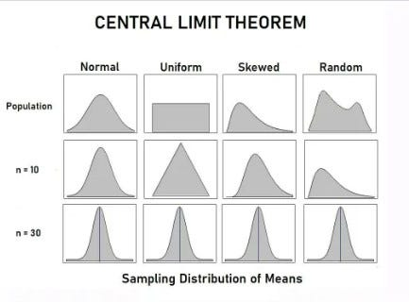
Central Limit Theorem and Additive Noise
Why Gaussian distribution for modeling additive noise?
The CLT proves if you take sufficiently large samples from a population, the samples’ means will be normally distributed, even if the population isn’t normally distributed.
This makes selecting noise from a Gaussian distribution a natural choice since even if we added noise from some other distribution, over time, the noise would converge to Gaussian.
Why make the process lengthier? We don’t.

Slide 13
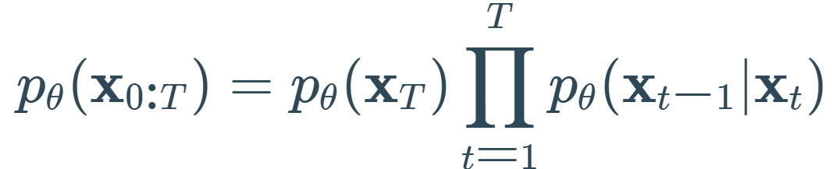
Reverse Diffusion (addn notes)
So long as noise was gradually added, two neighboring samples are identical => the noise can be described by a normal distribution with some mean and variance.
The noise removal process is not deterministic (++generalization) since it is described by a Gaussian distribution.
Given an input noisy image, the NN predicts the mean and variance at every timestamp, samples from the distribution and removes the predicted noise until a clear image is formed.
Given x_{t} , find x_{t-1 .}
Unlike the forward process, we don’t have access to the reverse probability distribution (computationally infeasible)
q( x_{t-1} | x_{t} )
We approximate the reverse distribution with a neural network.
Notes:
How diffusion models work: the math from scratch | AI Summer
Lesson 9B - the math of diffusion - YouTube

Slide 14
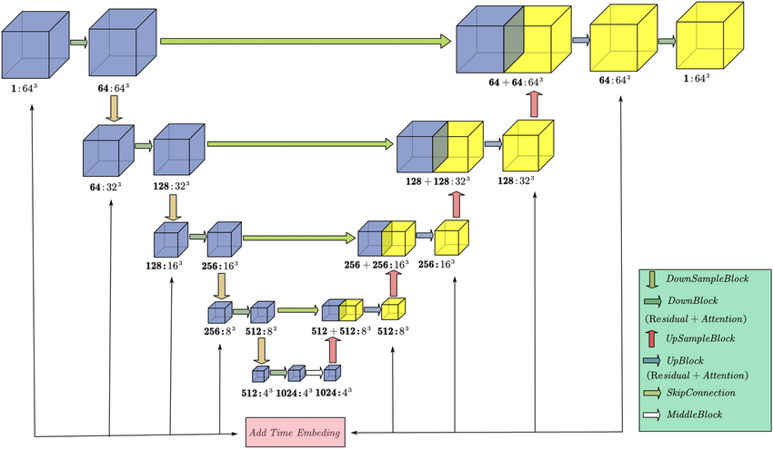
Training (addn notes)
UNet architecture (based on CNN and skip connections) was originally used by the authors of 2020 DDPM paper.
The architecture used sinusoidal timestep embeddings to account for timestamps.
Sample a batch of images.
Sample random timesteps.
Add noise according to schedule.
Predict noise with the model.
Compute MSE loss.
Backpropagate and update weights.
Repeat

